Slide 1
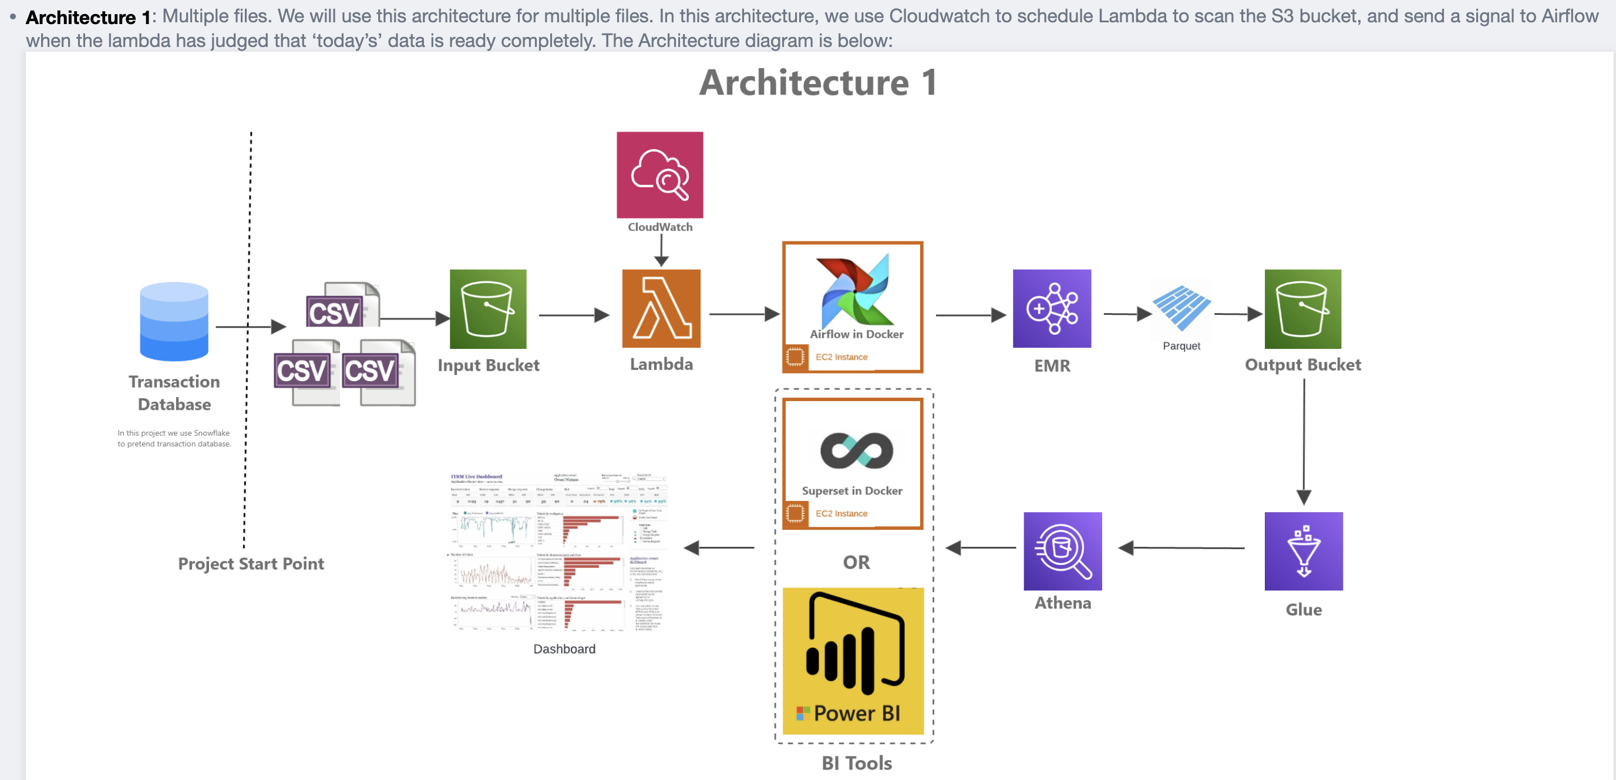

Slide 2
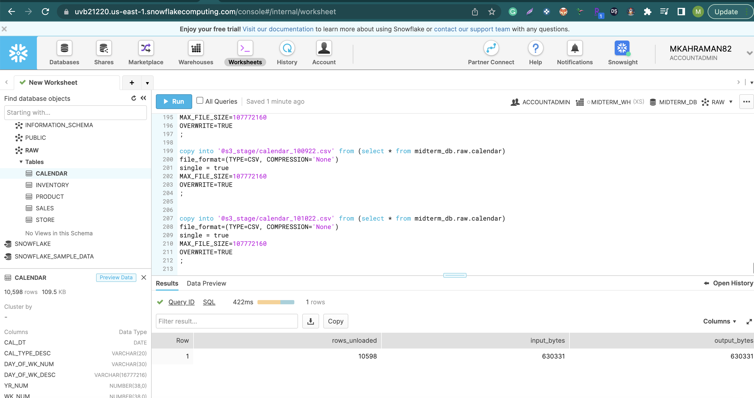
SNOWFLAKE to S3 BUCKET
first dump transaction data from a transaction database.

Slide 3
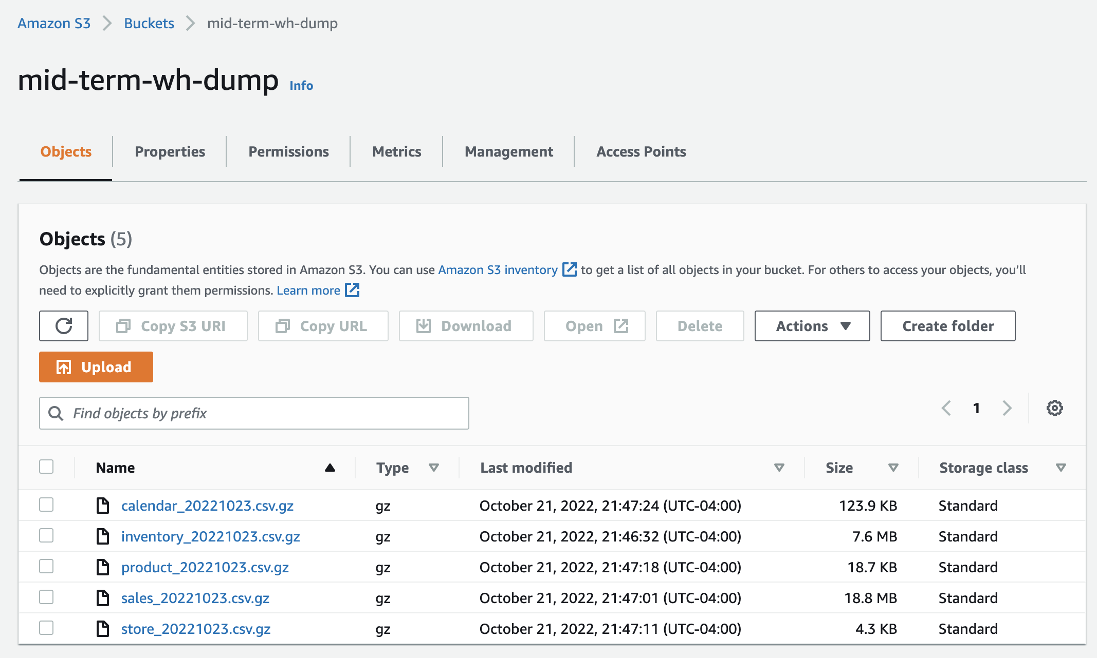
Raw Files in S3 Bucket

Slide 4
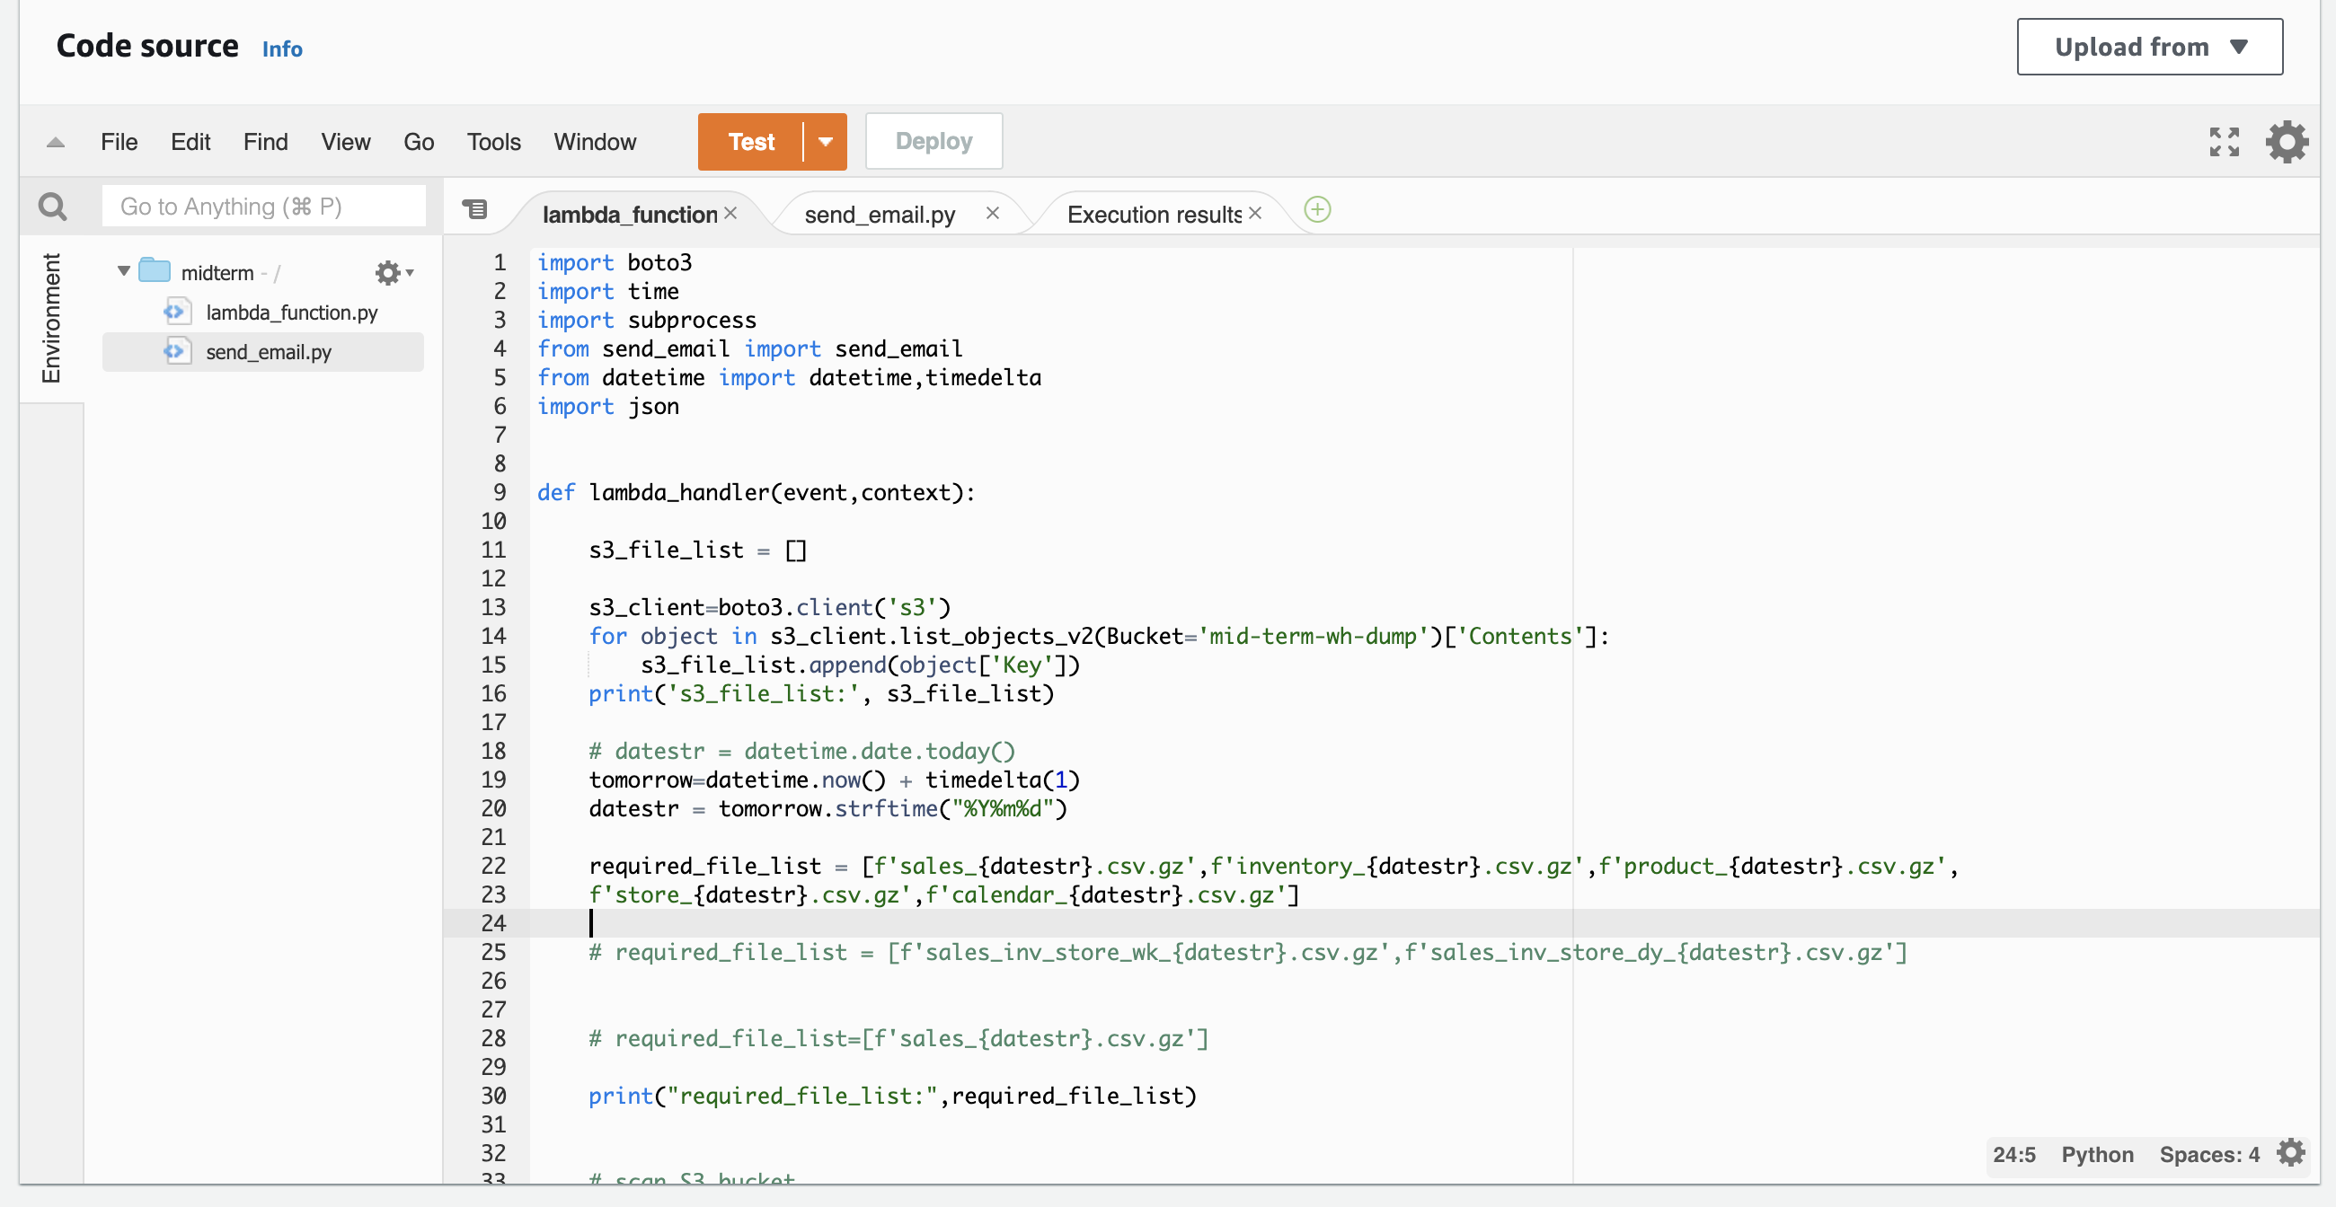
Lambda Function

Slide 5
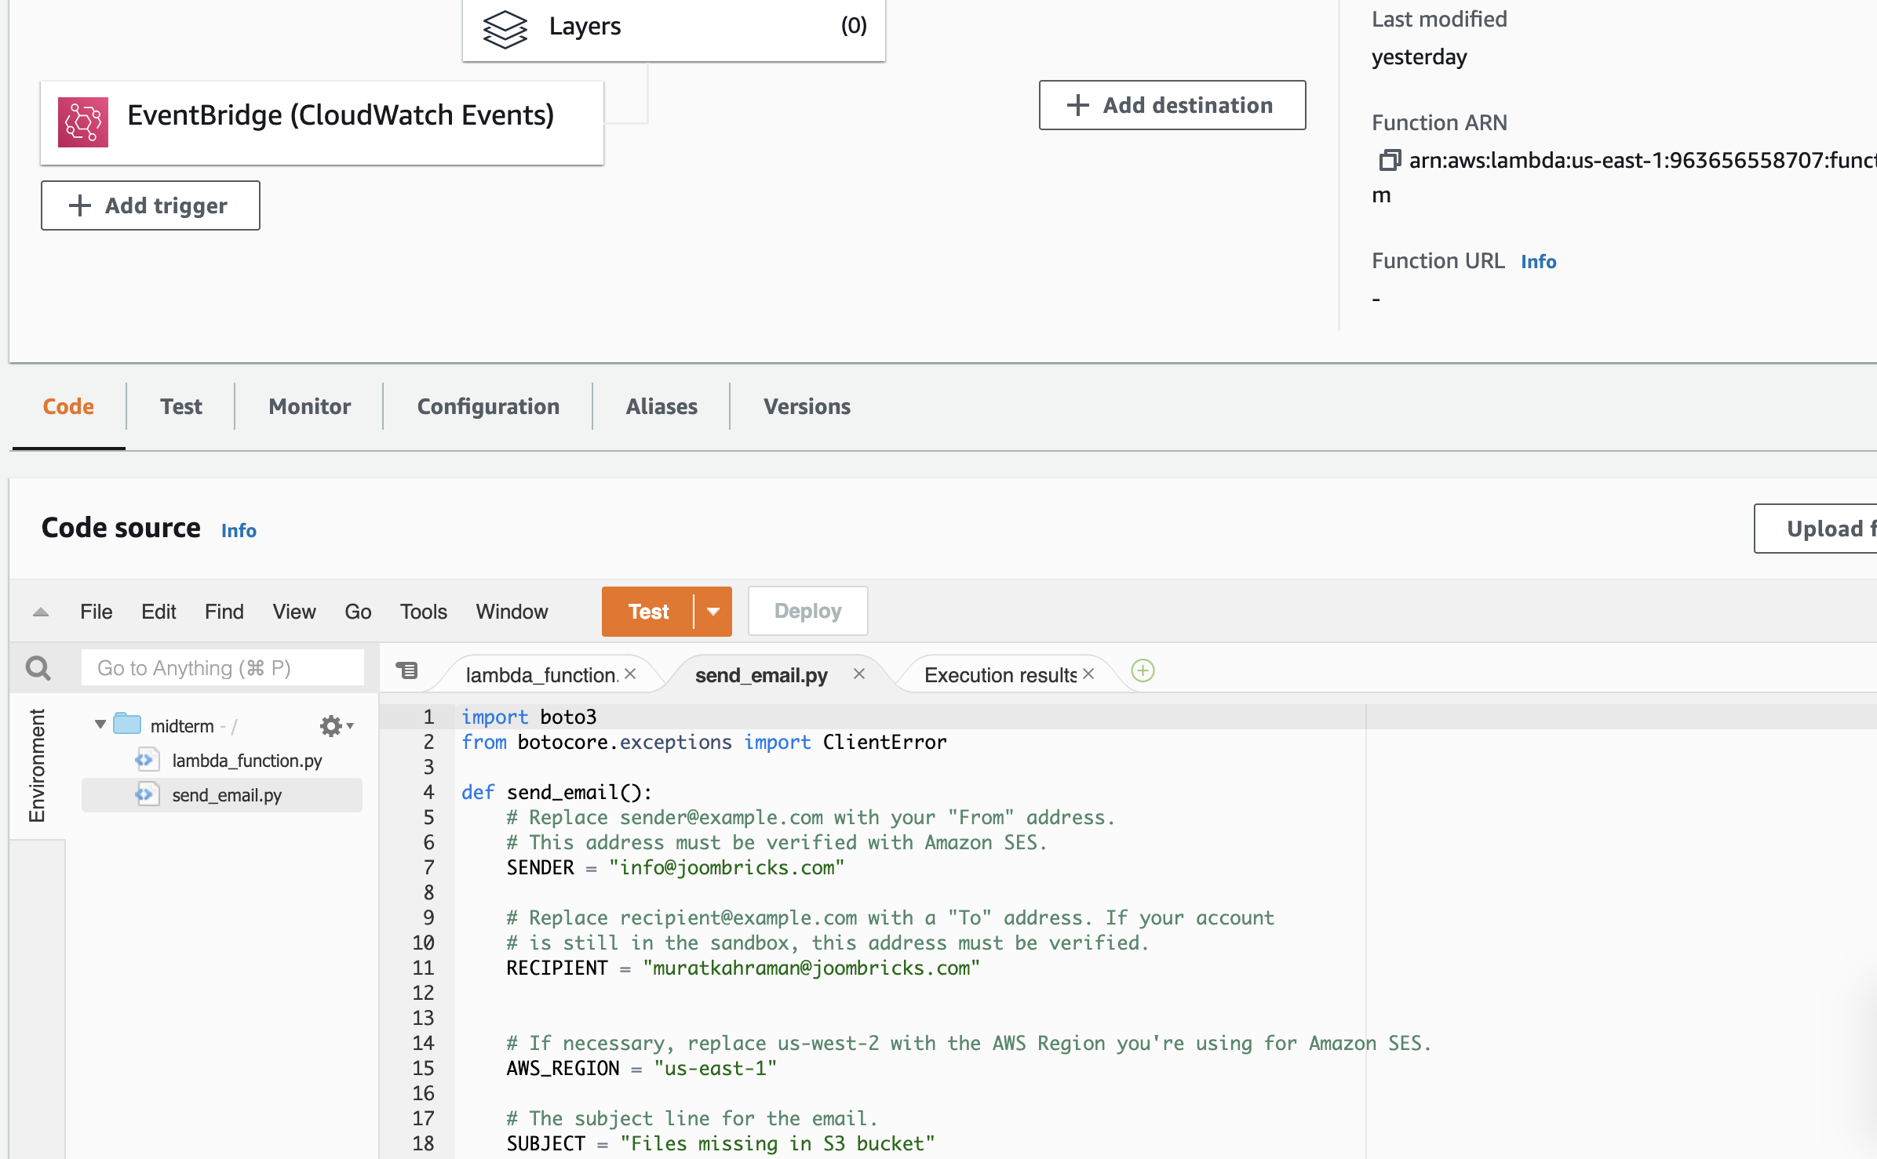
Lambda Function

Slide 6
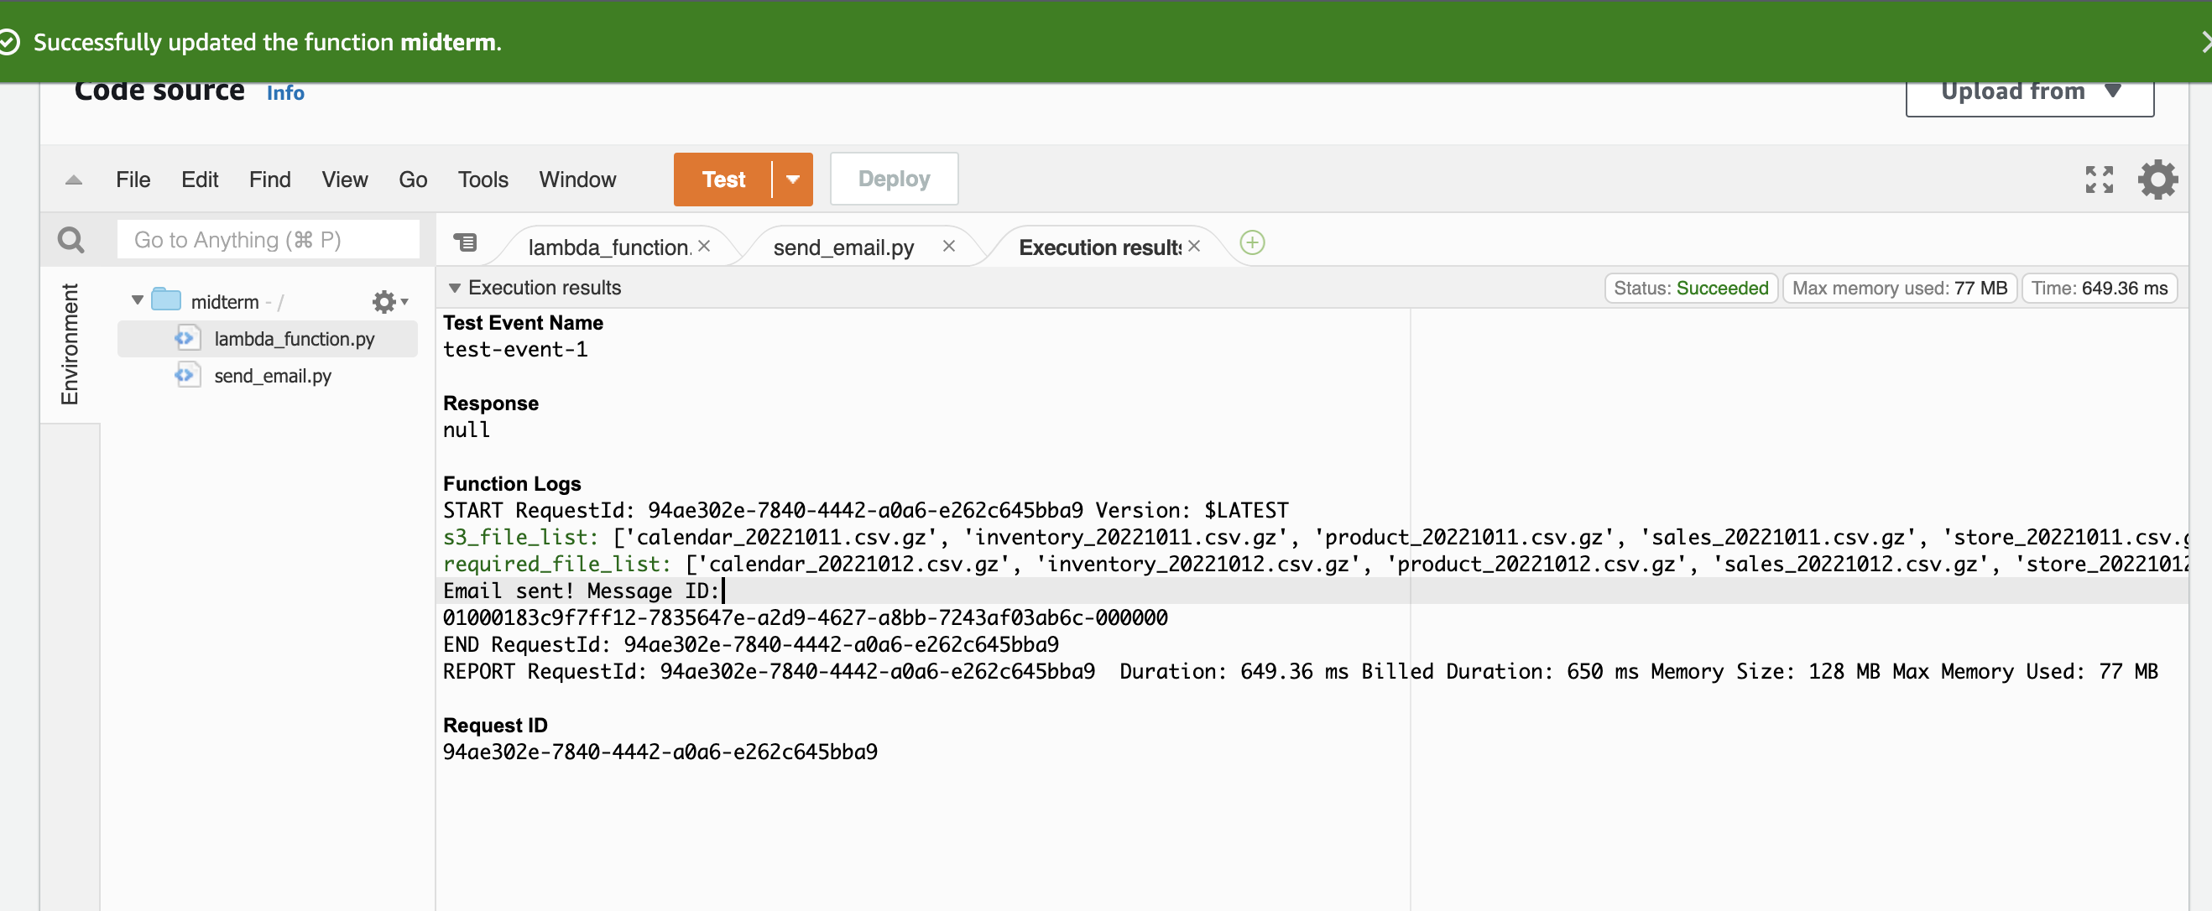
Lambda Function email sent message

Slide 7
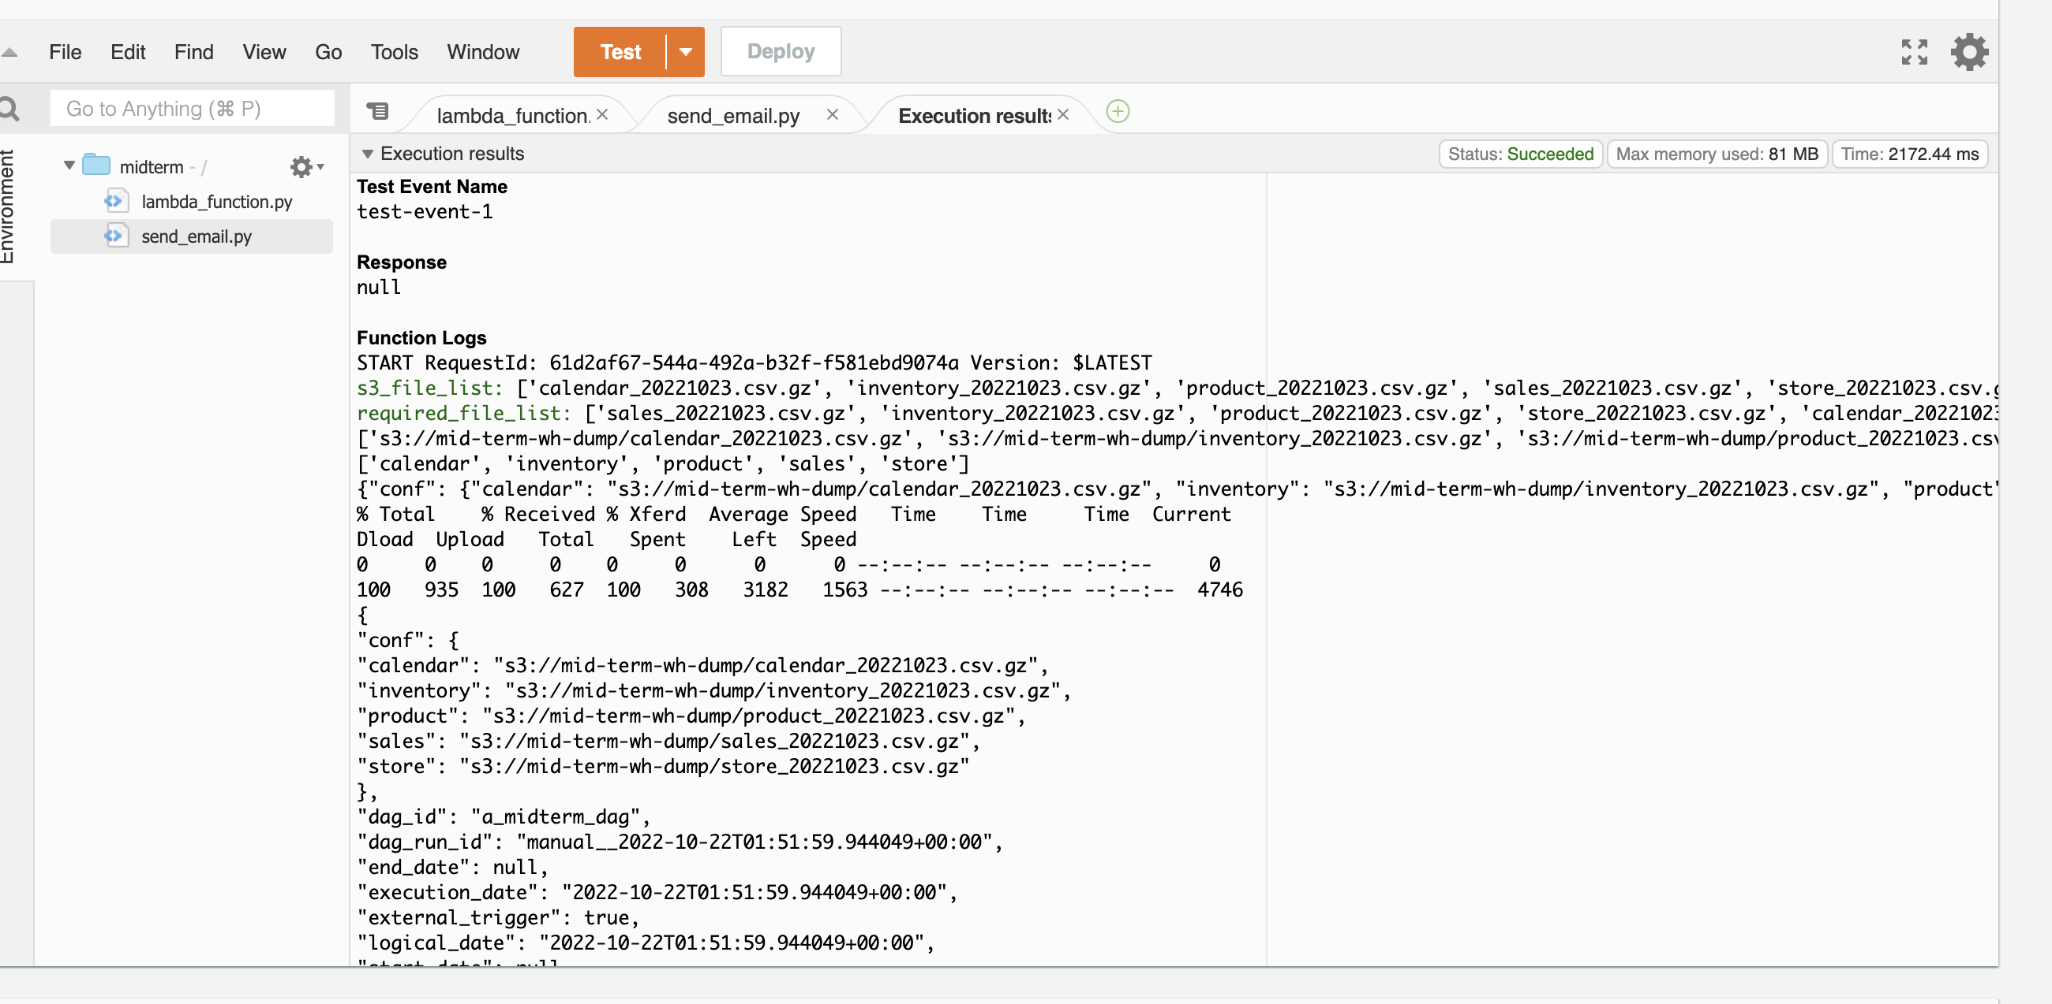
Files sent to the Airflow

Slide 8
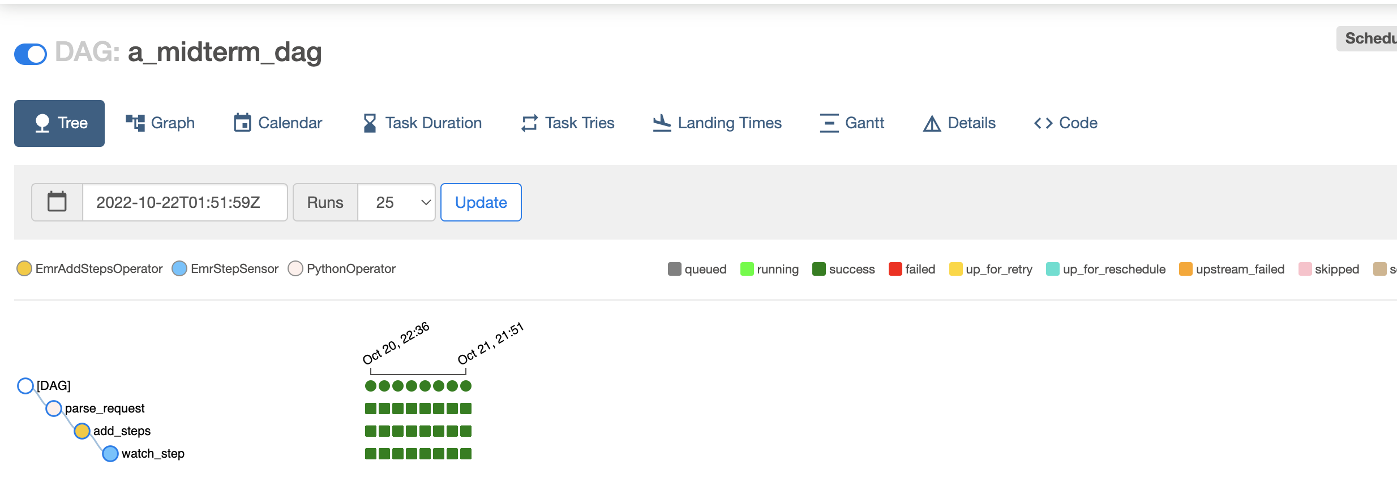
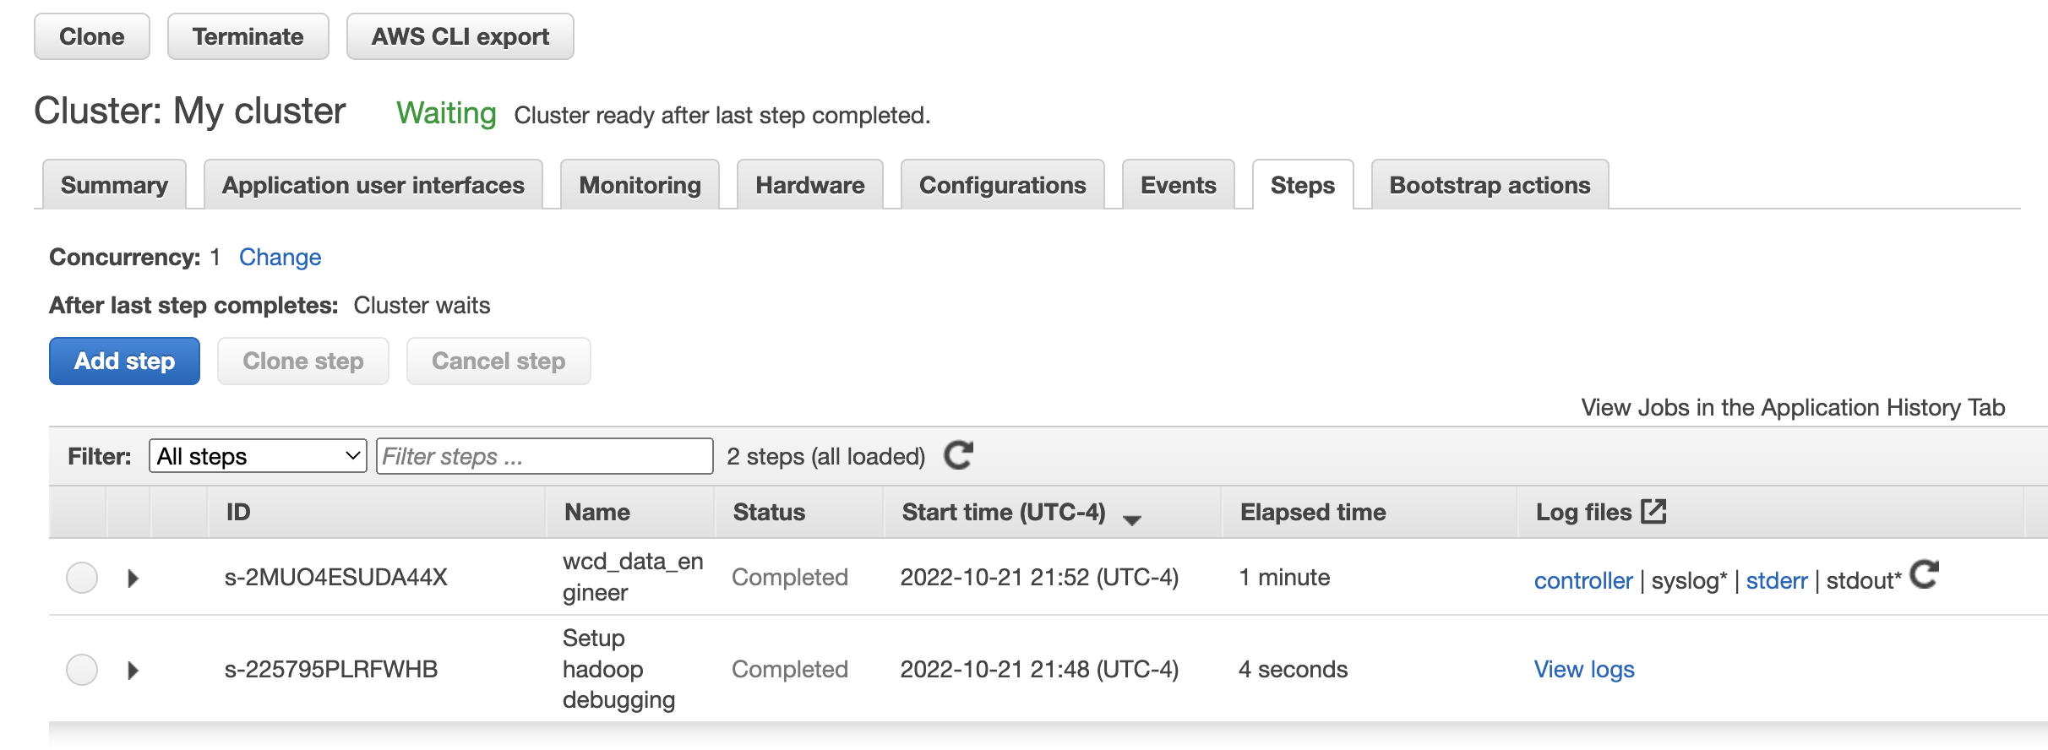
Airflow + EMR run successfully

Slide 9
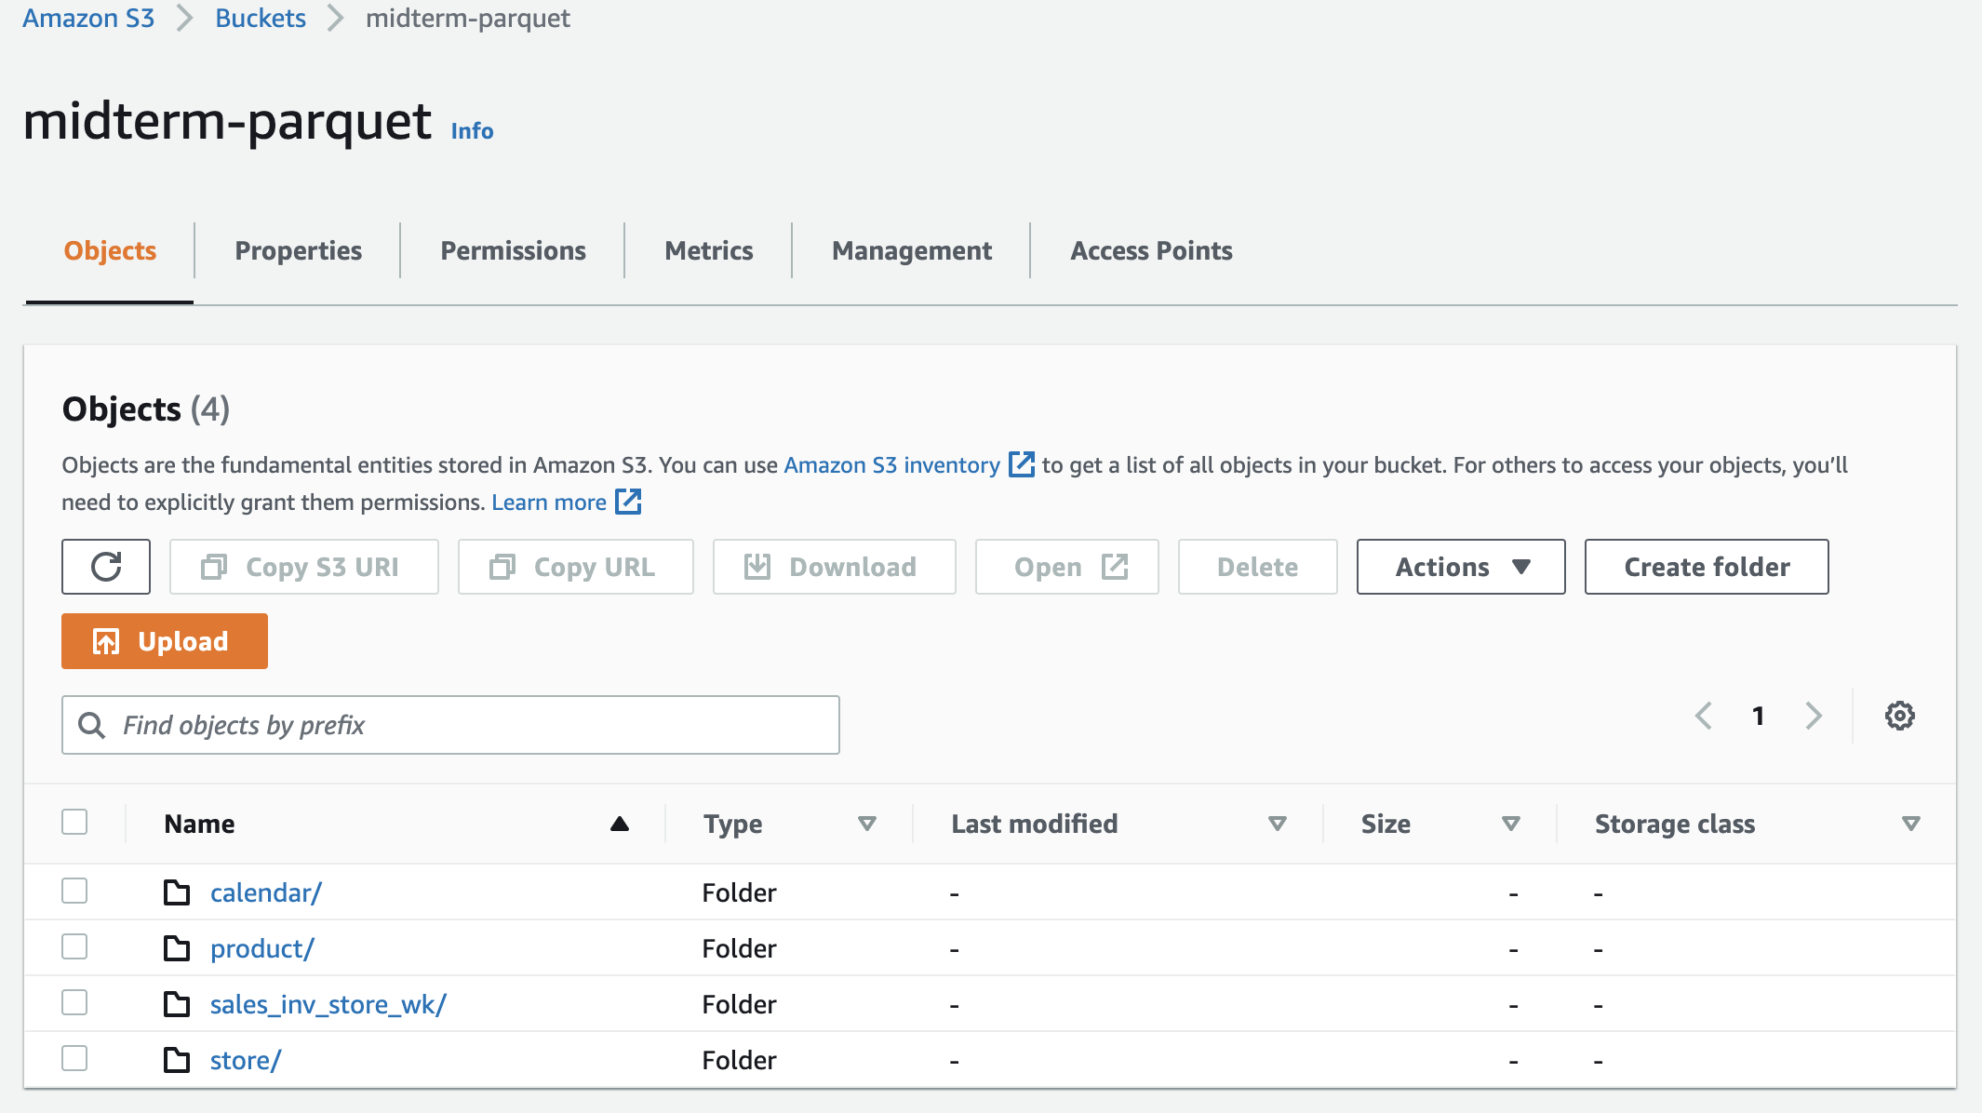
Parquet Files in S3 Bucket

Slide 10
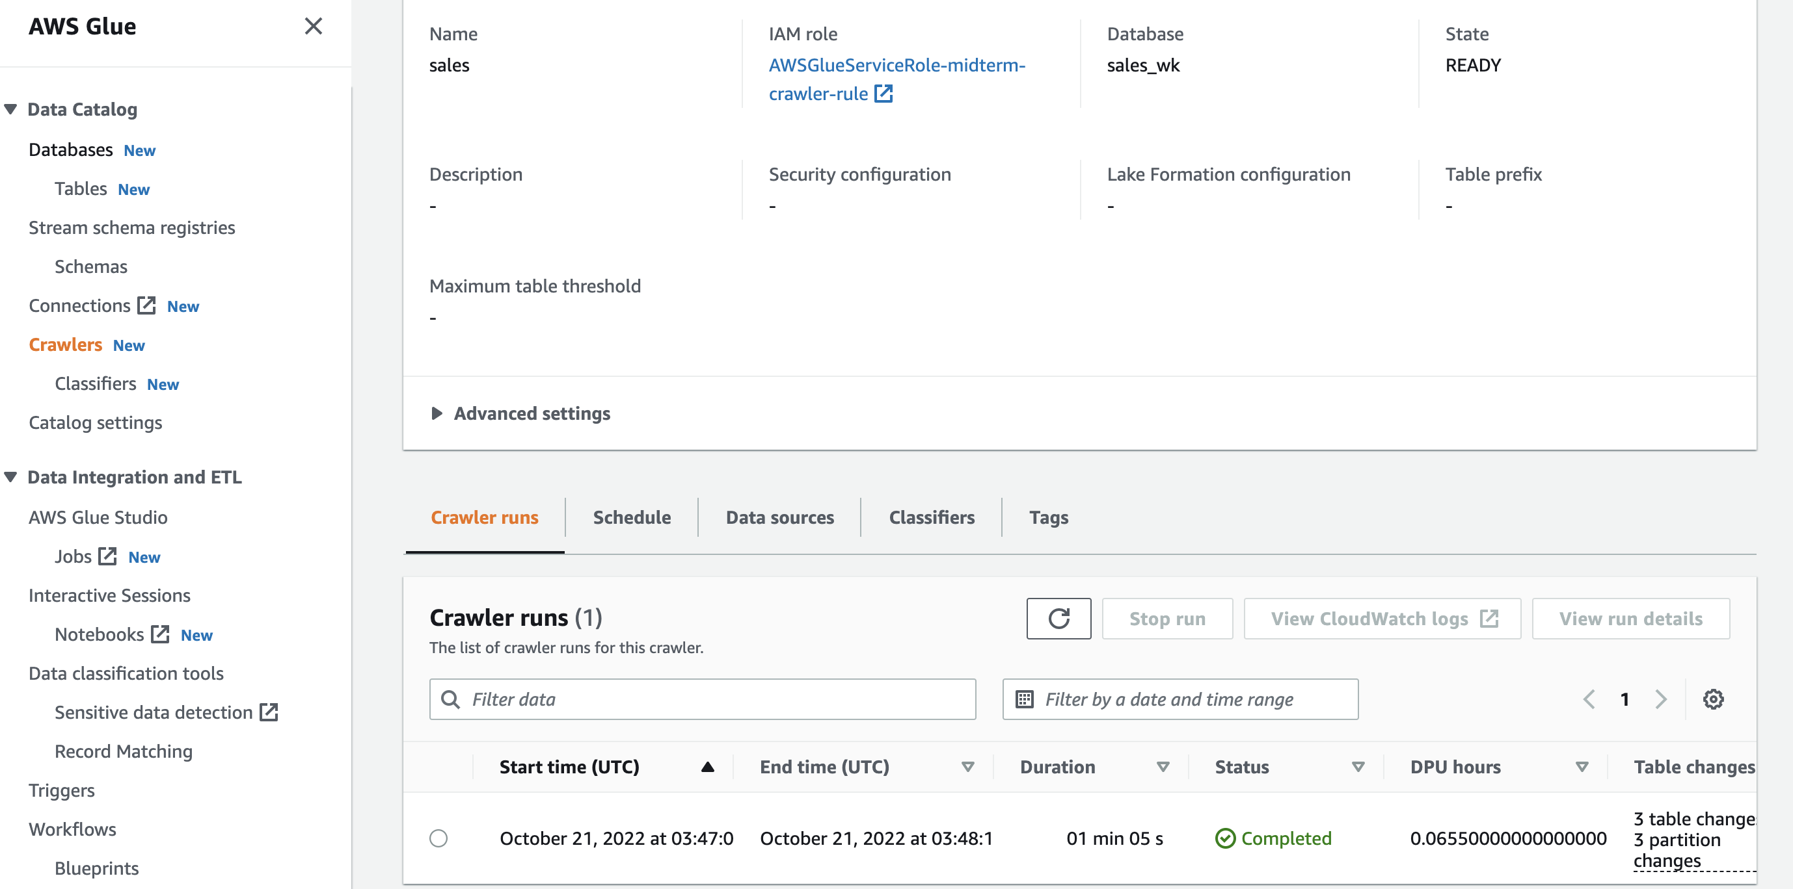
AWS GLUE CRAWLER

Slide 11
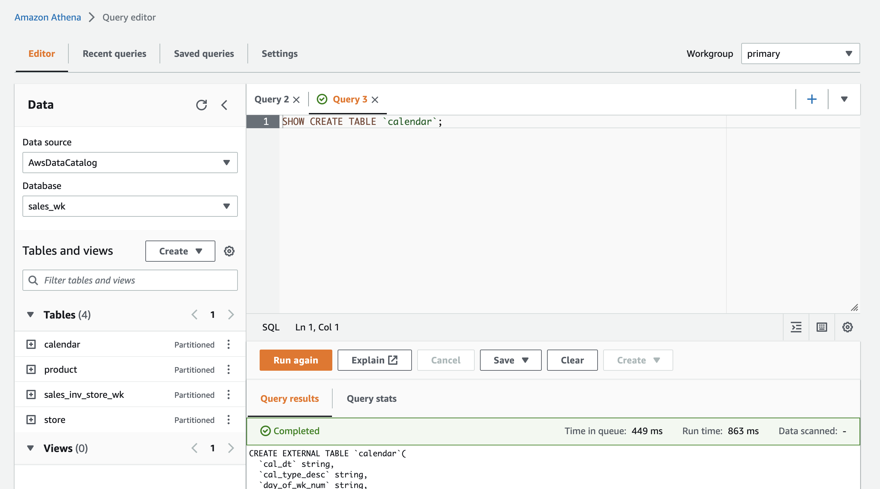
ATHENA

Slide 12
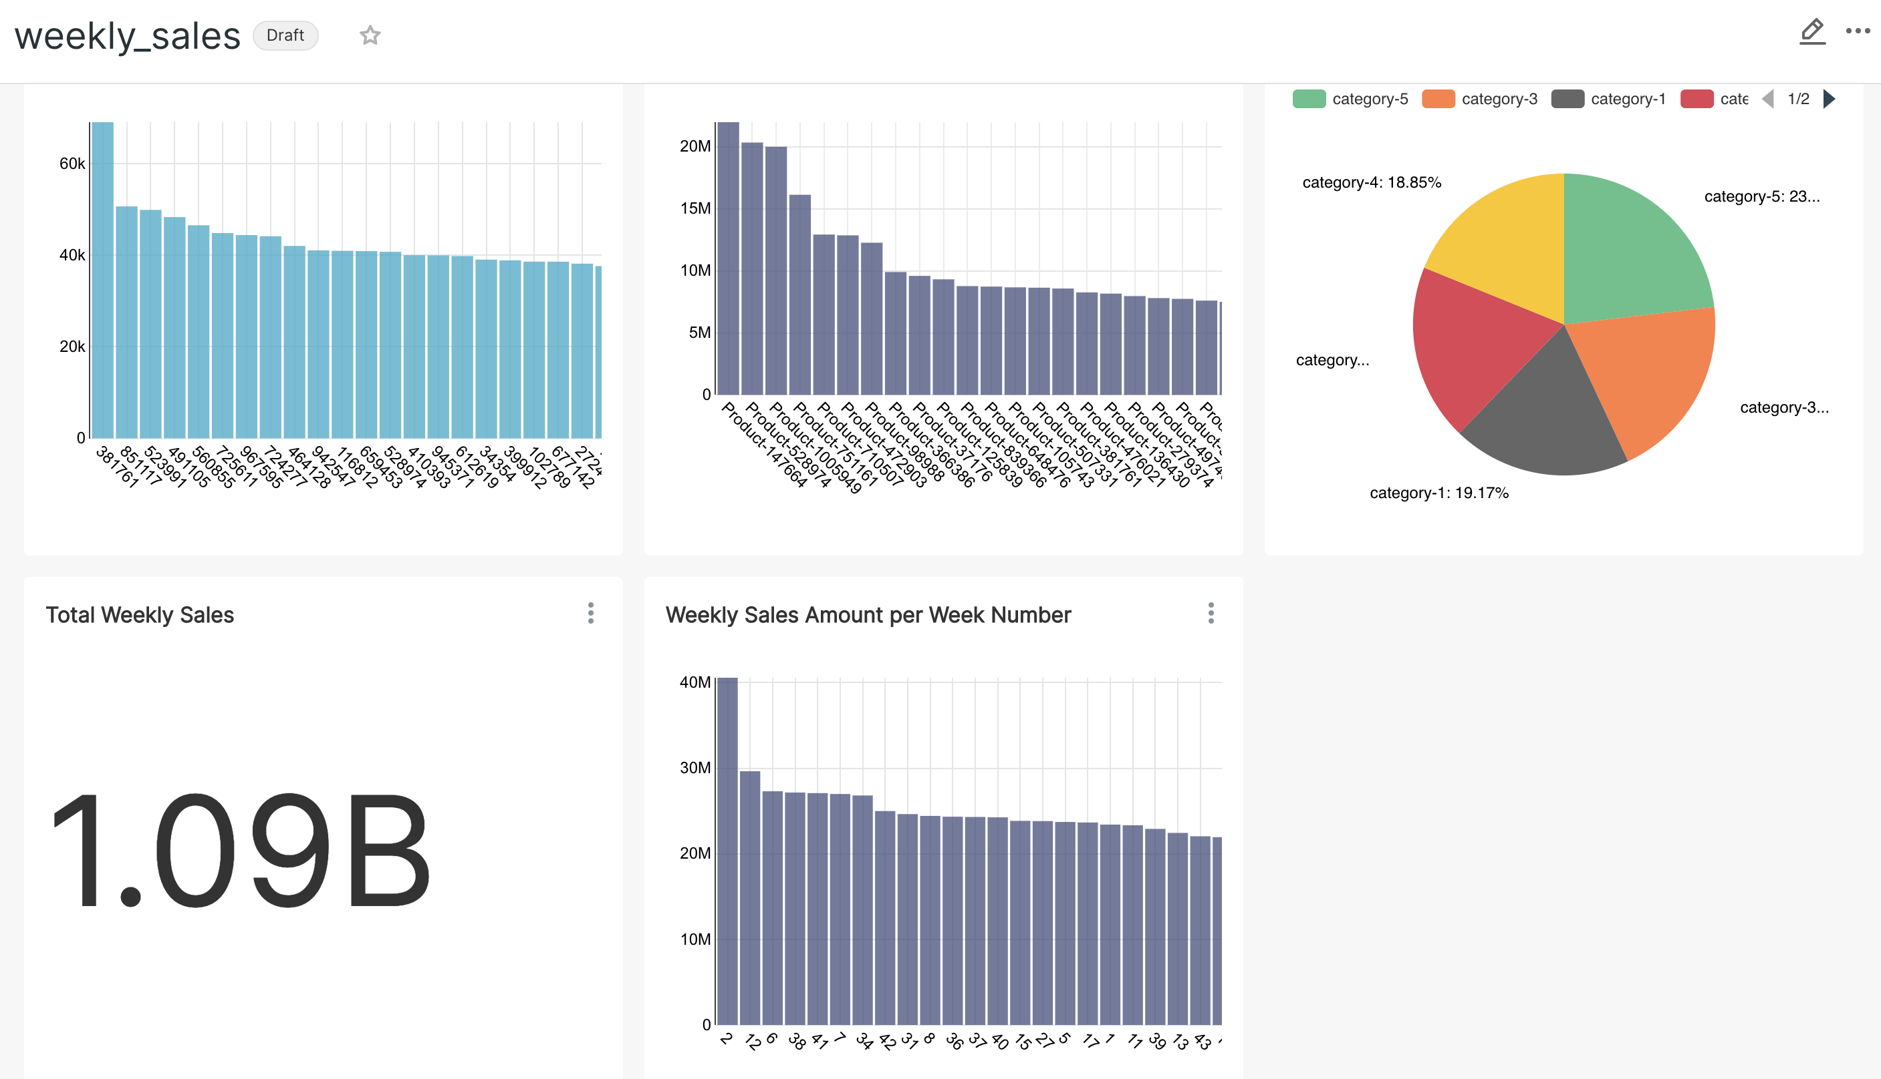
SUPERSET

